Slide 1
My AI/ML Internship Journey
By Ramchandra Satyawan Rane
Internship Final Presentation

Slide 2
My 8-Week Mission
My internship followed a structured 8-week plan, taking me from the basics to building a complete AI application.
The Goal: To learn how to build AI that is not just smart, but also useful and reliable.
Weeks | My Mission
1-2 | Learn the Tools (Python, LangChain)
3-5 | Build AI Assistants (My Projects)
6-8 | Make Them Stronger & Report

Slide 3
The Toolkit: What I Used
To build my AI projects, I used a set of modern and powerful tools.
LangChain: The "brain" that connects everything together. It helps the AI think and plan.
OpenAI: Provided the powerful GPT-3.5 language model that understands and writes text.
Streamlit: A simple way to build the user interface (the chat window our users see).
Pinecone & FAISS: Special "vector" databases that help the AI find the right information quickly, like a super-smart search engine.
Python: The programming language used for everything.

Slide 4
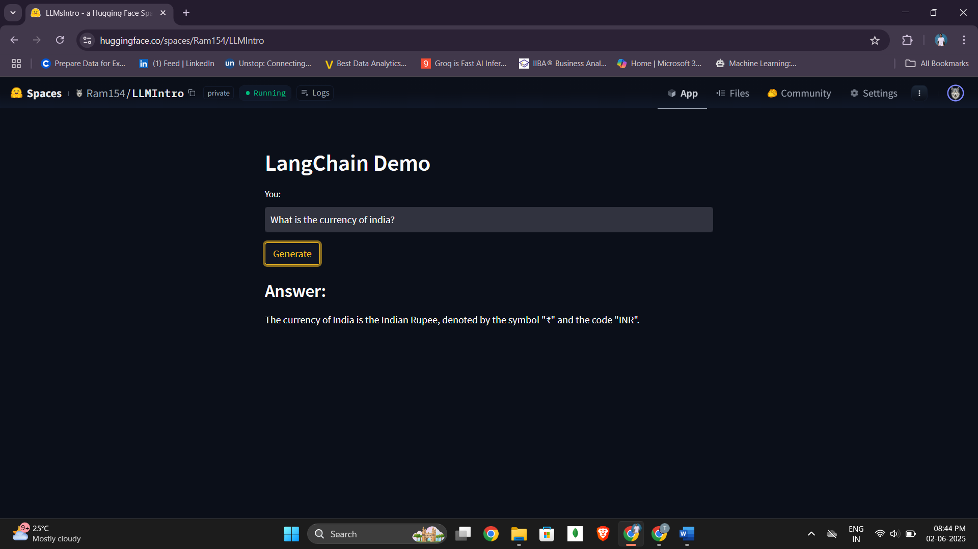
Week 3 - My First Chatbot
My first project was to build a simple chatbot.
The Challenge: Make a chatbot that doesn't forget what you just said.
What I Built:
A chat window where you can talk to an AI.
The AI uses Memory to remember the conversation.
I also built a version where you could tell the AI to act like a "Doctor" or a "Legal Expert".
This taught me the basics of making a conversational AI.

Slide 5
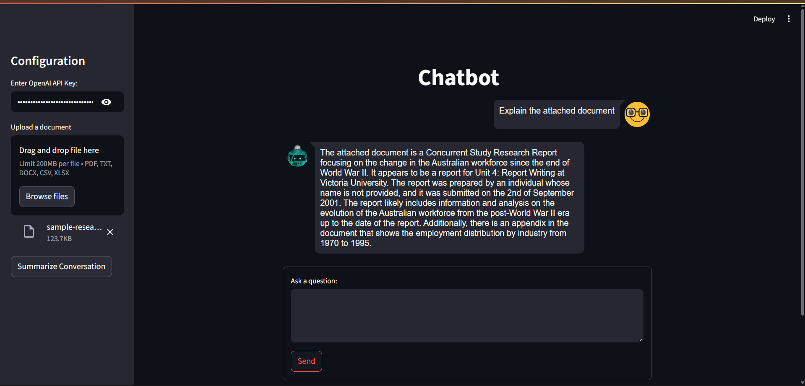
The Big Idea: Making the Chatbot Smarter
A normal chatbot only knows what it was trained on. How can we make it answer questions about our documents?
The answer is Retrieval-Augmented Generation (RAG).
It's a simple idea:
Retrieve: First, the AI finds the most relevant information from a document.
Generate: Then, it uses that information to create a smart answer.
Your Question ➡️ Find Right Info in PDF ➡️ Give Smart Answer

Slide 6
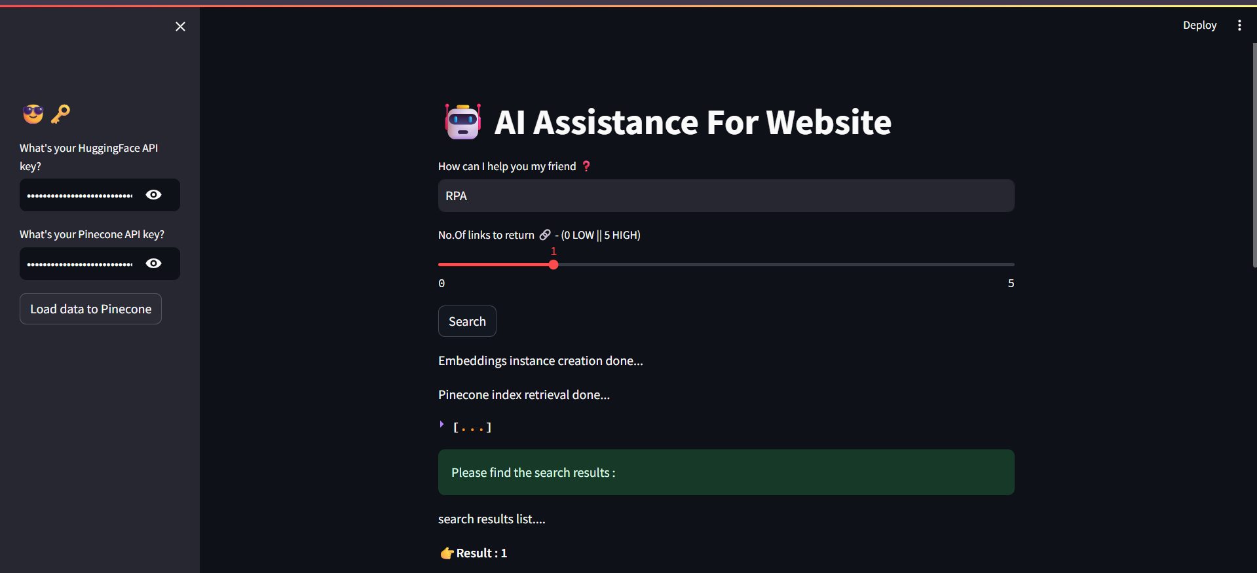
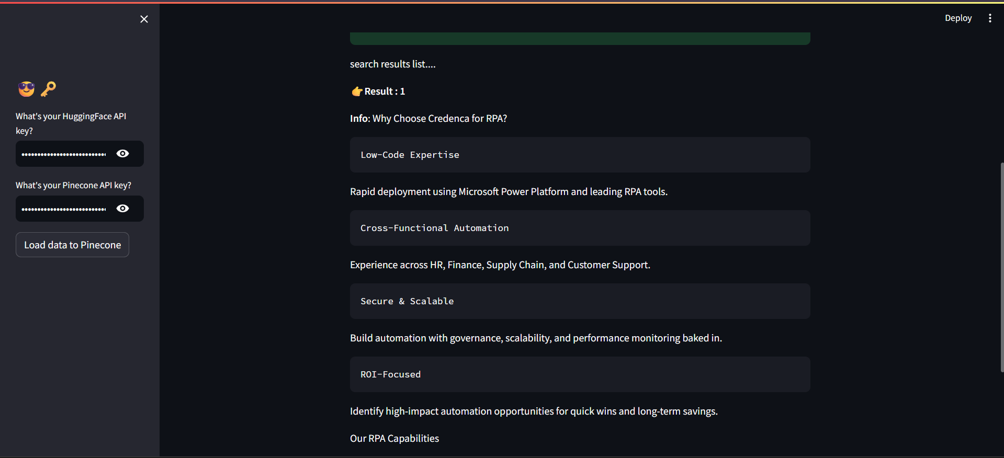
The Website Chatbot
My next project used the RAG idea to build an expert on a website.
The Challenge: Create a bot that can answer any question about a specific website.
How it Worked:
The program read all the text from a website.
It stored this information in a Pinecone database.
When a user asked a question, the bot would search Pinecone for the answer and reply.
This was my first full RAG project and a huge step forward!

Slide 7
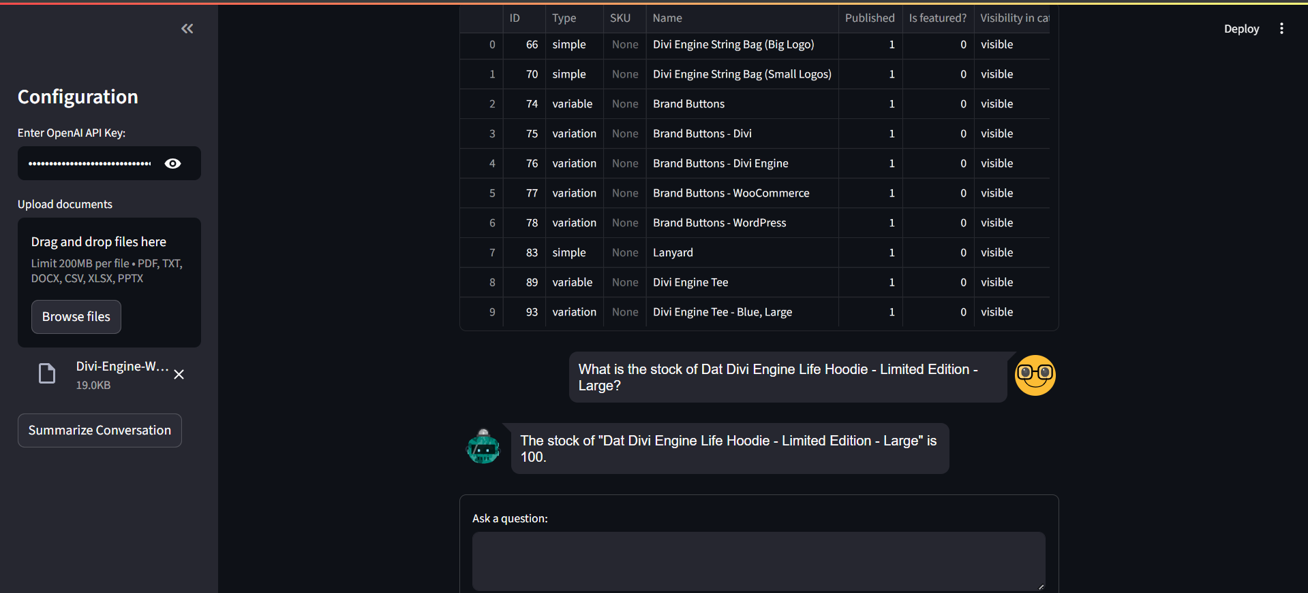
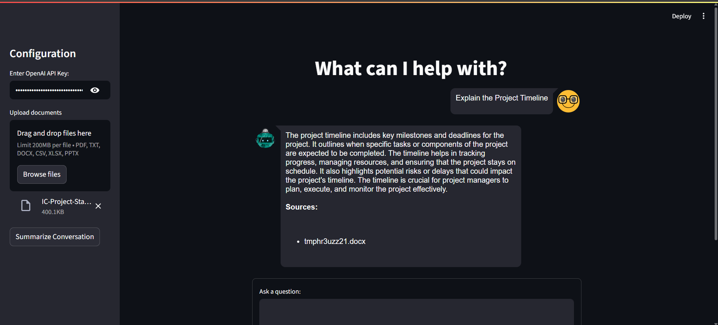
Week 5 (Part 1) - The Multi-Talented Assistant
My initial Week 5 project was an "Ultimate AI Assistant" designed to be a flexible data expert.
The Goal: Build one AI assistant that can handle almost any document you give it.
What it Could Do:
Chat with Documents: You can upload PDFs, Word files, or text files and ask questions about them.
Analyze Spreadsheets: It could also read CSV or Excel files and answer questions like "What were the total sales in April?" using a Pandas Agent.

Slide 8
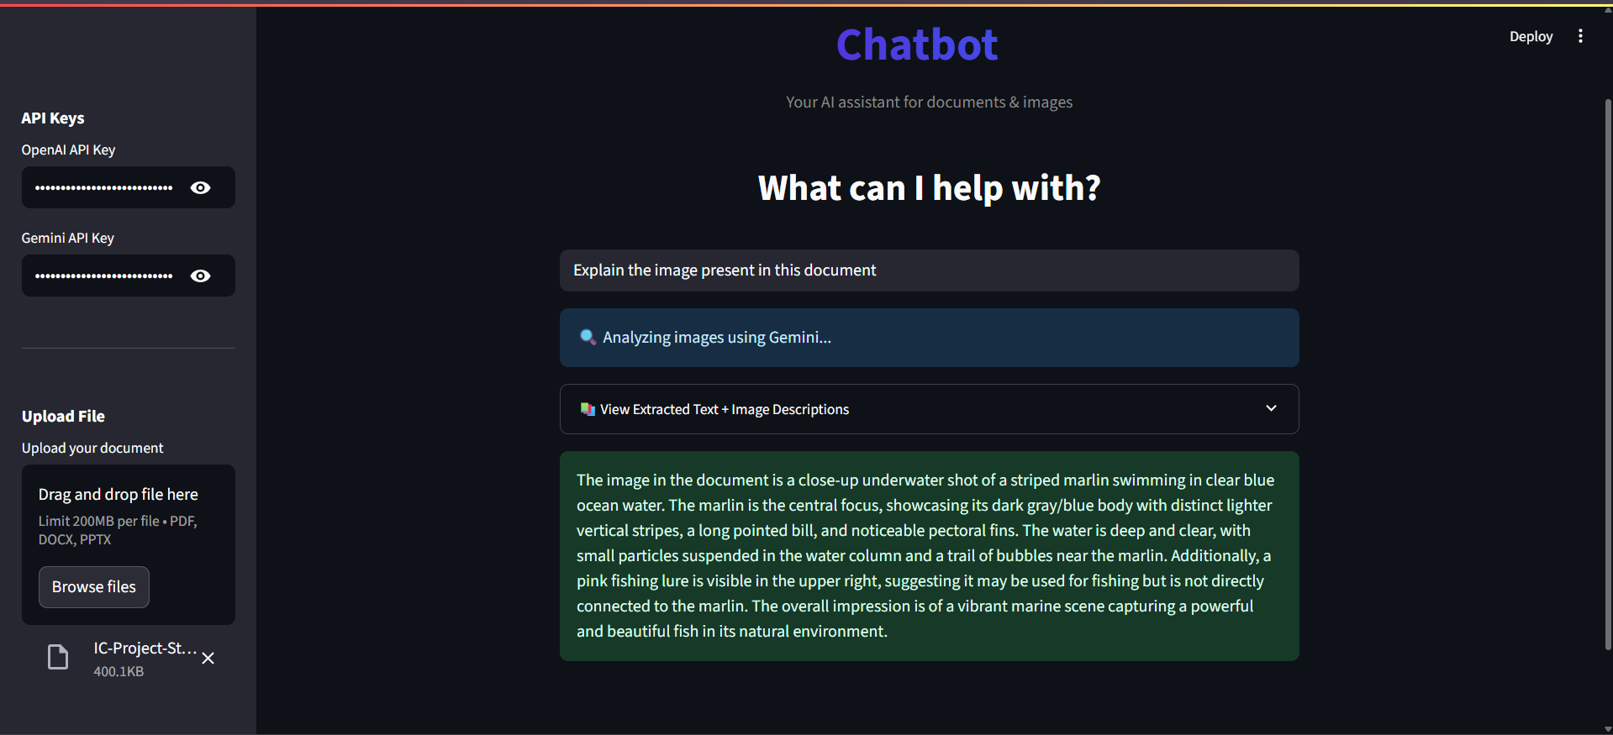
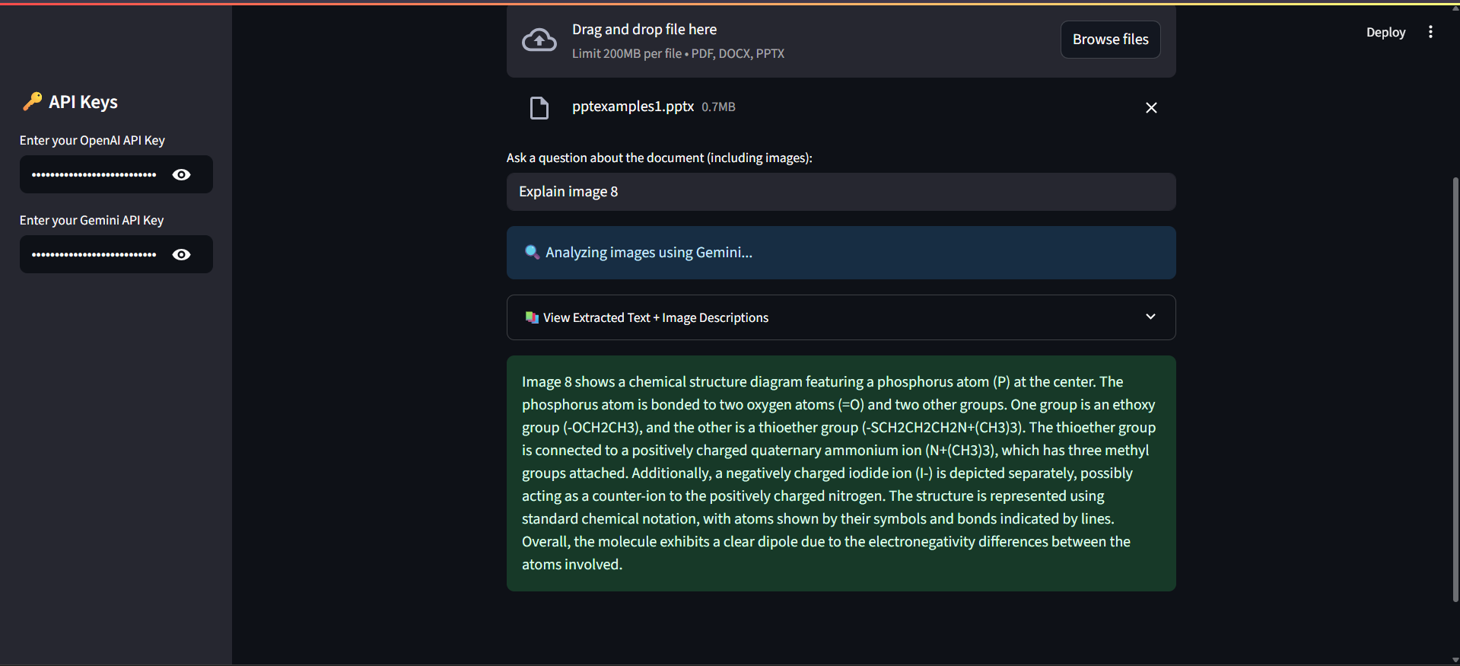
Week 5 (Part 2) - Evolving to an Image Expert
The New Goal: Create a bot that truly understands the images inside a document, not just reads the text.
How it Works:
Step 1: Gemini Analyzes the Images: The app sends every image to Google's Gemini 1.5 Flash model, which generates a rich, detailed description of what's happening in the picture.
Step 2: OpenAI Answers the Questions: The app then combines the document's text with Gemini's image descriptions. This full context is given to OpenAI's GPT model to answer the user's question with complete understanding.

Slide 9
Making It Strong and Reliable
A good app doesn't just work, it works well. In Week 6 and 7, I focused on making the assistant better.
Faster Responses: I used caching so the app doesn't have to do the same work twice.
Error Handling: I added retry logic, so if the AI has a problem connecting to the internet, it tries again automatically.
Testing: I wrote a full set of unit tests to check that every part of the code works correctly and to prevent future bugs.

Slide 10
Conclusion
This internship was an amazing journey from learning the basics to building complex, useful AI applications.
What I Achieved:
Mastered the LangChain framework for building AI apps.
Successfully built sophisticated RAG systems for smart information retrieval.
Prototyped both a multi-purpose data assistant and a specialized vision-language model application.
Integrated two different powerful AI models (Google Gemini for vision, OpenAI for language) into a single, seamless application.

Slide 11
Thank you to my mentor and the entire team of Credenca for this incredible opportunity.

